Slide 1
Model Evaluation & Evaluation Metrics

Slide 2
Introduction
The goal of regression is to build a model to accurately predict an unknown case.
After building the model, we have to perform regression evaluation.
Here, we’ll discuss two types of evaluation approaches that can be used to achieve this goal.
These approaches are: train and test on the same dataset, and train/test split.

Slide 3
When considering evaluation models, we clearly want to choose the one that will give us the most accurate results.
So, the question is, how we can calculate the accuracy of our model?
In other words, how much can we trust this model (such as linear regression) for prediction of an unknown sample, using a given a dataset ?
There are 2 approaches

Slide 4
Train and Test on the SAME dataset.
In this approach, you train the model on the entire dataset, then you test it using a portion of the same dataset.
For instance, assume that we have 10 records in our dataset.
We use the entire dataset for training, and we build a model using this training set.
Now, we select a small portion of the dataset, such as row numbers 6 to 9, but without the labels.
This set, is called a test set, which has the labels, but the labels are not used for prediction, and is used only as ground truth.
The labels are called “Actual values” of the test set.

Slide 5
Now, we pass the feature set of the testing portion to our built model, and predict the target values.
Finally, we compare the predicted values by our model with the actual values in the test set.
This indicates how accurate our model actually is.
Let’s look at one of the simplest metrics to calculate the accuracy of our regression model.
The error of the model is calculated as the average difference between the predicted and actual values for all the rows.

Slide 6
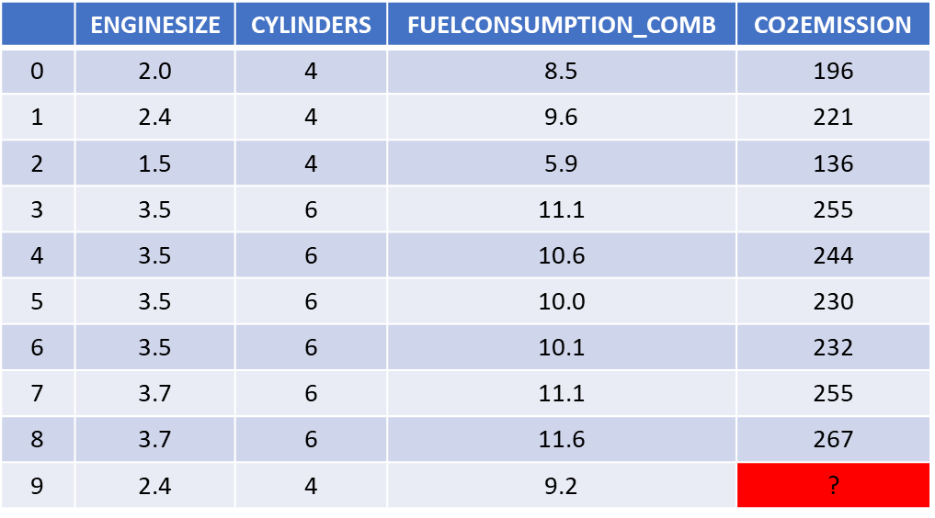
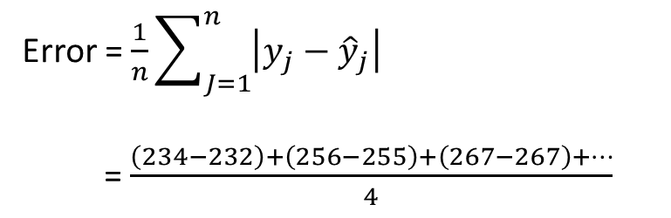
Error = $\frac{1}{n}\sum_{J=1}^{n}{\left|y_{j}−{\hat{y}}_{j}\right|}$
= $\frac{\left(234−232\right)+\left(256−255\right)+\left(267−267\right)+…}{4}$
Train
 | Prediction
6 | 234
7 | 256
8 | 267
9 | 210
Test
ŷ
y
212
Actual values
Predicted
values

Slide 7
This evaluation approach would most likely have a high “training accuracy” and a low “out-of-sample accuracy”, since the model knows all of the testing data points from the training.
Training accuracy: It is the percentage of correct predictions that the model makes when using the test dataset.

Slide 8
A high training accuracy isn’t necessarily a good thing.
For instance, having a high training accuracy may result in an ‘over-fit’ of the data.
This means that the model is overly trained to the dataset, which may capture noise and produce a non-generalized model.
Doing a “train and test” on the same dataset will most likely have low out-of-sample accuracy due to the likelihood of being over-fit.

Slide 9
So, how to improve out-of-sample accuracy?
By using another evaluation approach called "Train/Test Split.

Slide 10
Train/Test Split
In this approach, we select a portion of our dataset for training, for example, rows 0 to 5 and the rest is used for testing, for example, rows 6 to 9.
The model is built on the training set.
Then, the test feature set is passed to the model for prediction.
And finally, the predicted values for the test set are compared with the actual values of the testing set.
This will provide a more accurate evaluation on out-of-sample accuracy because the testing dataset is NOT part of the dataset that has been used to train the data.
It is more realistic for real world problems.

Slide 11
Since we know the outcome of each data point in this dataset, it is great to test with such database!
Since this data has not been used to train the model, the model has no knowledge of the outcome, thus making it truly out-of-sample testing.
However, please ensure that you train your model with the testing set afterwards, as you don’t want to lose potentially valuable data.
The issue with train/test split is that it’s highly dependent on the datasets on which the data was trained and tested.
Another evaluation model, called "K-Fold Cross-validation," resolves most of these issues.

Slide 12
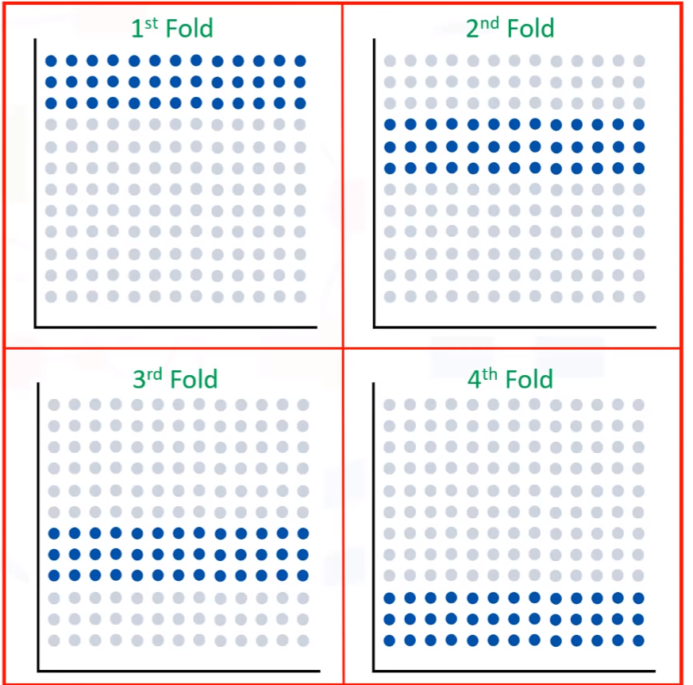
The entire dataset is represented by the points in the image at the top left.
If we have k=4 folds, then we split up this dataset as shown here.
In the first fold, for example, we use the first 25 percent of the dataset for testing, and the rest for training.

Slide 13
Then, in the next round (or in the second fold), the second 25 percent of the dataset is used for testing and the rest for training the model.
Again the accuracy of the model is calculated.

Slide 14
Evaluation Metrics

Slide 15
Introduction
Evaluation metrics provide a key role in the development of a model, as it provides insight to areas that require improvement.
We’ll be reviewing a number of model evaluation metrics, including:
Mean Absolute Error (MAE),
Mean Squared Error (MSE), and
Root Mean Squared Error (RMSE).

Slide 16
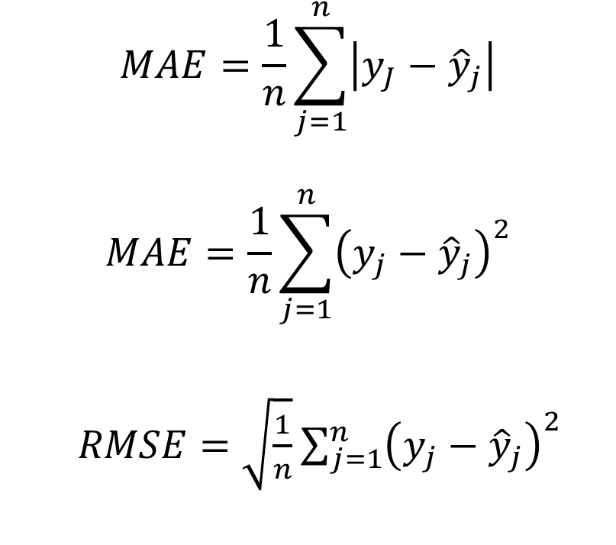
Mean absolute error (MAE) is the mean of the absolute value of the errors.
It’s just the average error.
Mean Squared Error (MSE) is the mean of the squared error.
It’s more popular than Mean absolute error because the focus is geared more towards large errors.
Root Mean Squared Error (RMSE) is the square root of the mean squared error.
Root Mean Squared Error is most popular because it is interpretable in the same units as the response vector (or ‘y’ units) making it easy to relate its information.
$$MAE=\frac{1}{n}\sum_{j=1}^{n}{\left|y_{J}−{\hat{y}}_{j}\right|}$$
$$MAE=\frac{1}{n}\sum_{j=1}^{n}{{\left(y_{j}−{\hat{y}}_{j}\right)}^{2}}$$
$RMSE=\sqrt{\frac{1}{n}}\sum_{j=1}^{n}{{\left(y_{j}−{\hat{y}}_{j}\right)}^{2}}$

Slide 17
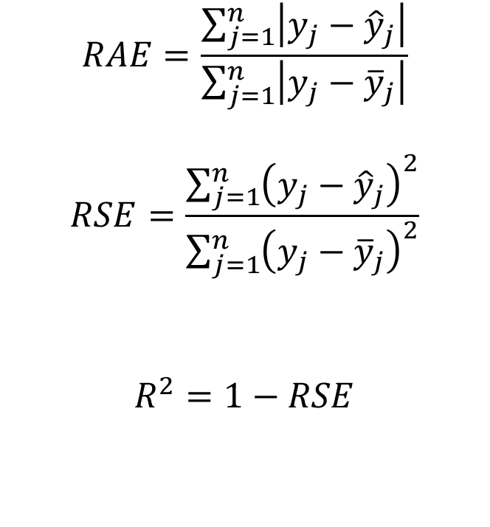
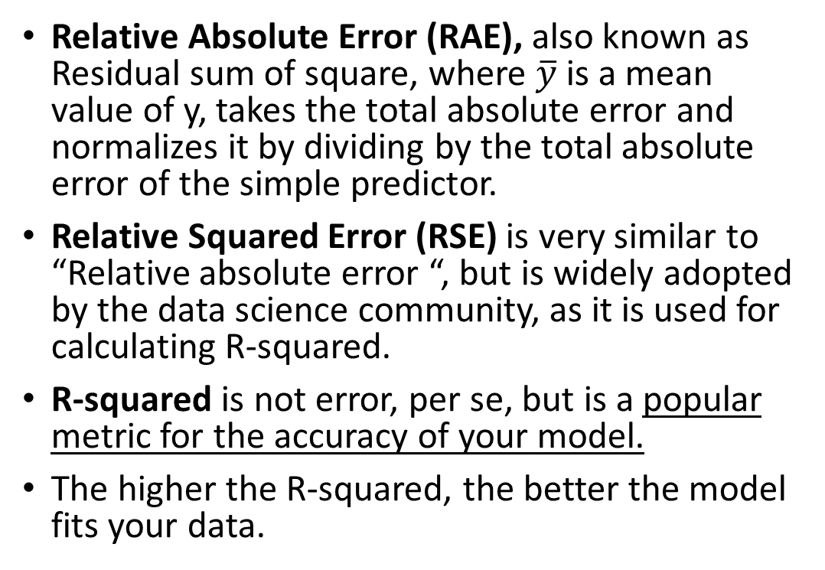
Relative Absolute Error (RAE), also known as Residual sum of square, where $\overline{y}$ is a mean value of y, takes the total absolute error and normalizes it by dividing by the total absolute error of the simple predictor.
Relative Squared Error (RSE) is very similar to “Relative absolute error “, but is widely adopted by the data science community, as it is used for calculating R-squared.
R-squared is not error, per se, but is a popular metric for the accuracy of your model.
The higher the R-squared, the better the model fits your data.
$$RAE=\frac{\sum_{j=1}^{n}{\left|y_{j}−{\hat{y}}_{j}\right|}}{\sum_{j=1}^{n}{\left|y_{j}−{\overline{y}}_{j}\right|}}$$
$$RSE=\frac{\sum_{j=1}^{n}{{\left(y_{j}−{\hat{y}}_{j}\right)}^{2}}}{\sum_{j=1}^{n}{{\left(y_{j}−{\overline{y}}_{j}\right)}^{2}}}$$
$$R^{2}=1−RSE$$

Slide 18
Each of these metrics can be used for quantifying of your prediction.
The choice of metric completely depends on the type of model, your data type, and domain of knowledge.

Slide 19

Please contact
Foundation for Innovation and Collaborative
Education
mentor@fice.in
www.fice.in
Please contact
Foundation for Innovation and Collaborative
Education
info@fice.in
mentor@fice.in
Notes:
Here are the lessons we are going to learn today.

